Slide 1
Details (Team 36)
Lakshmi Ranga Sai Contact No.: 7660968568
Harsh Jaggi Contact No.: 7302647132
Harsh Joshi Contact No.: 8591289409
Jatin (Leader) Contact No.: 8003398009
Pranita Dwivedi Contact No.: 7652087091
Swati Kumari Contact NO.: 9905979101

Slide 2
Abstract
The project aims to develop a fruit recognition system using Convolutional Neural Networks (CNN). The system will take images of various fruits as input and classify them into their respective categories. The CNN model will be trained on a large dataset of fruit images using transfer learning to improve accuracy and efficiency. The system will be designed to work in real-time, with the potential to be integrated into a mobile application or a smart refrigerator to assist with grocery shopping and inventory management. The results of this project have the potential to significantly impact the fruit industry and improve the overall user experience in terms of convenience and efficiency.

Slide 3
Motivation
Firstly, the project aims to automate fruit recognition, which is currently a manual and time-consuming task. By using CNNs to classify fruits from images, we can reduce the human effort required and speed up the process of fruit recognition. This can be particularly beneficial in industries such as food processing, where large quantities of fruits need to be sorted and classified quickly.
Secondly, the project can improve the accuracy of fruit recognition. While humans are generally good at recognizing fruits, there are often subtle differences between different varieties that can be challenging to detect. CNNs can learn to identify these differences and classify fruits with high accuracy, even in cases where the differences are too subtle for humans to detect.
Thirdly, the project can enable new applications in areas such as smart agriculture, food waste reduction, and personalized nutrition. For example, a fruit recognition system can be used to identify the ripeness of fruits, which can help farmers optimize harvesting times and reduce food waste. Similarly, a smart grocery shopping app can use fruit recognition to provide personalized nutrition recommendations based on the user's fruit preferences.
Overall, the fruit recognition project using CNN is motivated by the potential to automate, improve, and enable new applications in the field of fruit recognition and related areas.

Slide 4
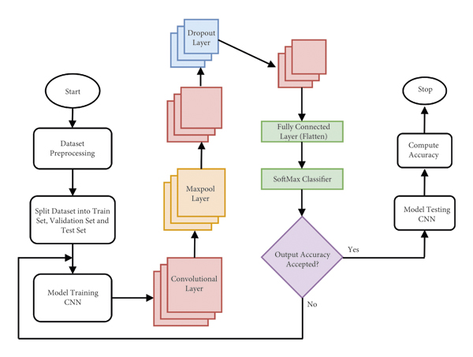
System Architecture

Slide 5
Module and Algorithm Description
Data Preprocessing Module: This module is responsible for preparing the input fruit images for use by the CNN model. The module may include techniques such as image resizing, normalization, and augmentation to ensure that the images are of a consistent size, brightness, and orientation, and that the model can learn to recognize fruit from different angles and lighting conditions.
CNN Model Architecture: The CNN model is the core algorithm used in the fruit recognition system. There are several popular CNN architectures that can be used for this purpose, such as VGG, ResNet, and Inception. These architectures typically consist of multiple layers of convolutional and pooling operations, followed by one or more fully connected layers that output a classification result.
Model Training Algorithm: The model training algorithm is responsible for optimizing the CNN model to achieve high accuracy on the fruit recognition task. The most common algorithm used for this purpose is backpropagation with stochastic gradient descent (SGD), which updates the model parameters based on the gradient of the loss function with respect to the weights.

Slide 6
4.Transfer Learning Technique: Transfer learning is a powerful technique that can be used to speed up the training process and improve the accuracy of the CNN model. This technique involves using a pre-trained CNN model, such as VGG or ResNet, as a starting point for training the fruit recognition model, and fine-tuning the model on a smaller dataset of fruit images.
5.Model Evaluation Metrics: To evaluate the performance of the fruit recognition system, several metrics can be used, including accuracy, precision, recall, and F1 score. These metrics provide a quantitative measure of how well the system is able to classify different types of fruit and can be used to compare different CNN architectures or training strategies.
6.Real-time Classification Algorithm: Once the CNN model has been trained, a real-time classification algorithm can be used to recognize fruit in new images. This algorithm involves feeding the input image through the CNN model and outputting the predicted fruit label with the highest probability.
Overall, these modules and algorithms are essential components of a fruit recognition project using CNN, and can be combined and customized to create a robust and accurate system for identifying different types of fruit.

Slide 7
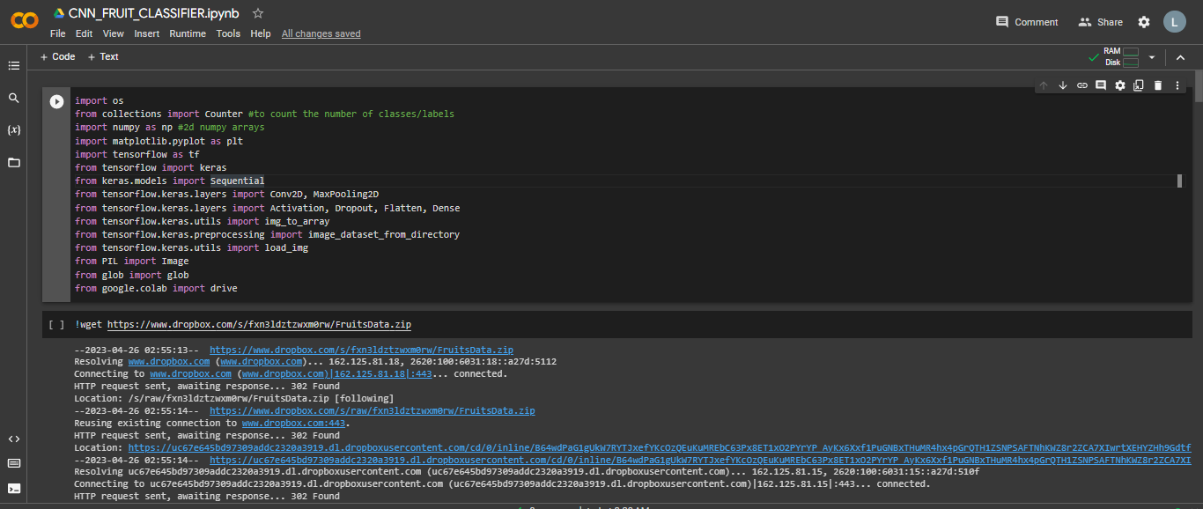
Screenshot of Importing all the libraries and importing Dataset from DROPBOX

Slide 8
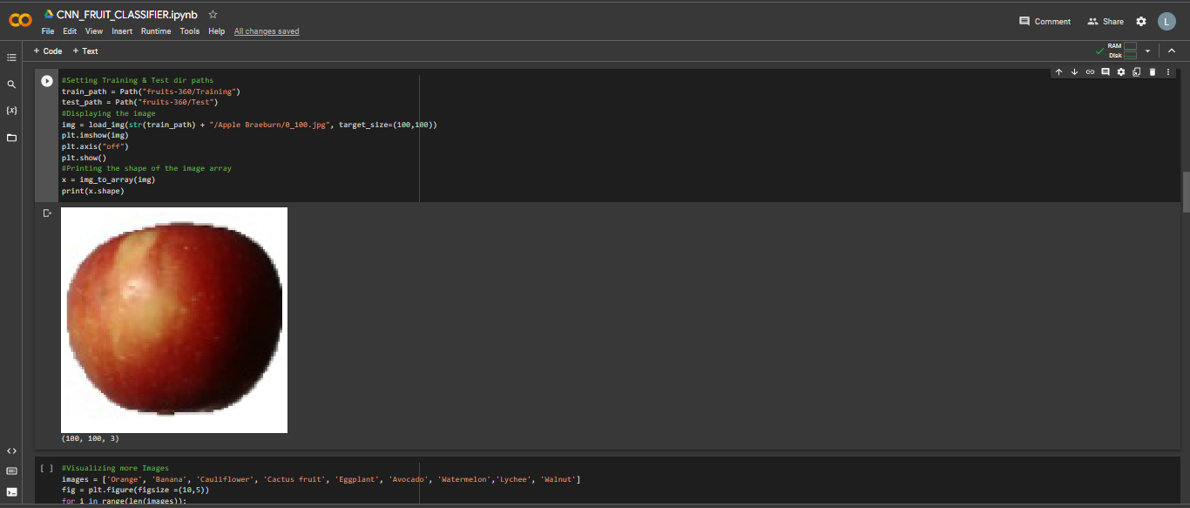
Screenshot of splitting of data into train & test and printing some images from dataset

Slide 9
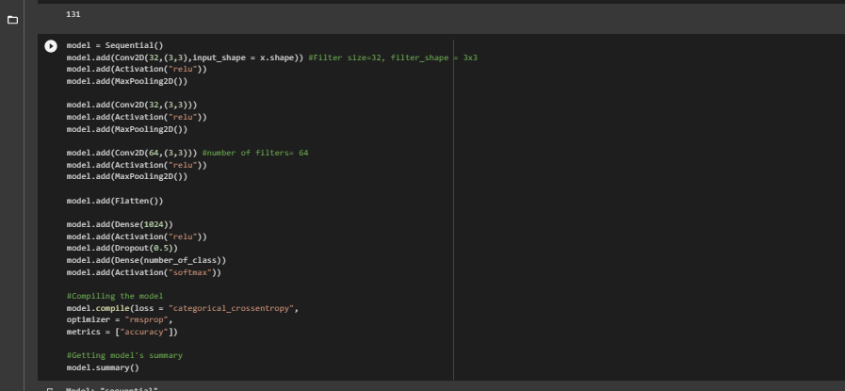
Screenshots of Model Training

Slide 10
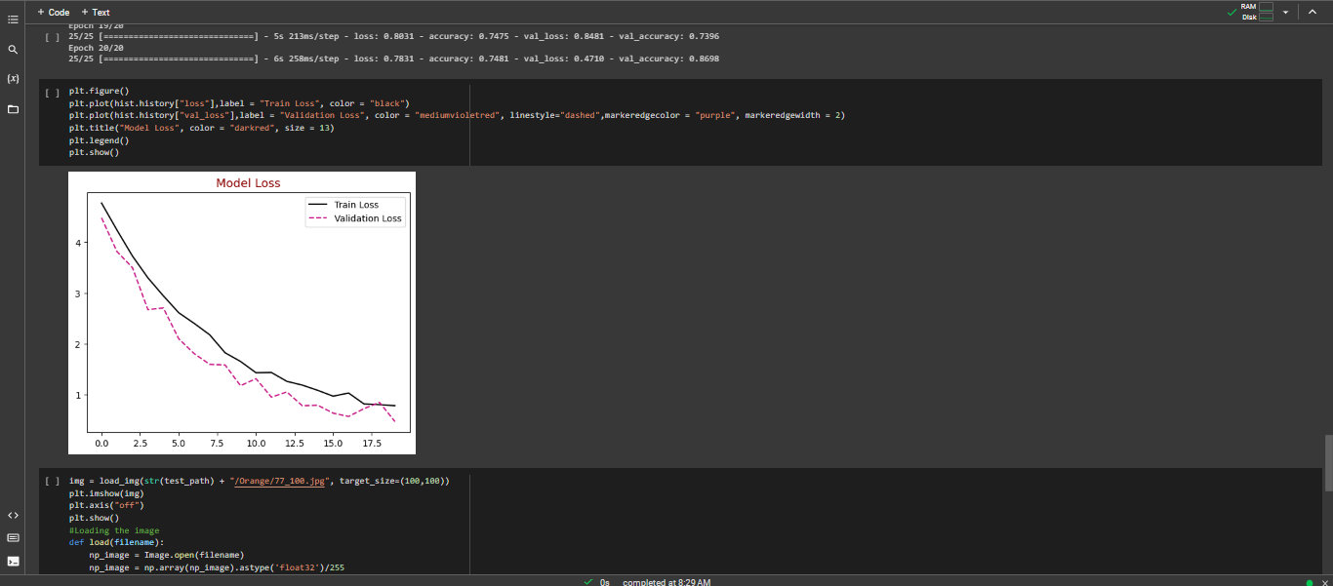
Loss Function

Slide 11
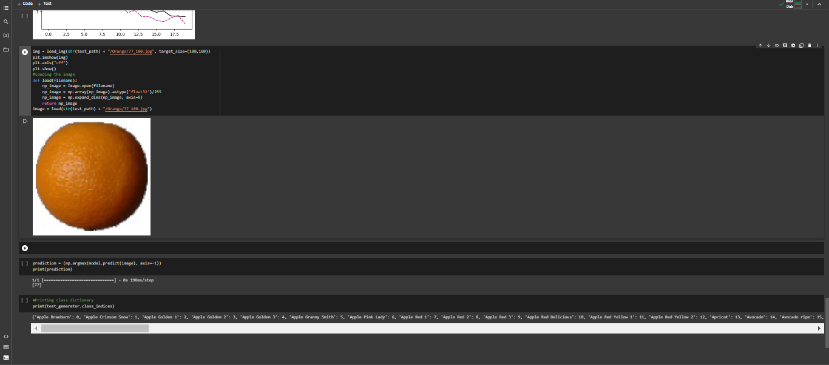
Inserting Random Image and Getting Fruit name as Output

Slide 12


